Slide 1
Inspirational Women painters of Modern India
Dr. Rashmi Jalota

Slide 2
Introduction
Contribution of Female Painters to the Modern Indian Painting
Indian context during the late 19th and 20th century
Notes:
India have produced many famous female painters who have contributed to the Modern Indian painting of India. Apart from being exceptional painters, many of them have been pioneers in the development of newer styles, choice of themes, mediums, etc. Many of them have even gone beyond and impacted the social structures existing during their era and become an inspiration for budding women artists.
This is particularly important in the Indian context during the late 19th century and most parts of 20th century as women were oppressed and discriminated. A few pioneering women artists of Modern India used their canvasses effectively to portray the social standing of women, their struggles, frustrations, dreams, etc. Those paintings brought the plight of women in spotlight and forced people to reflect on the lives of Indian women & their standing in the society.
This research is an attempt to study the life and thought provoking works of few such inspirational women painters of modern Indian art. Most of these painters have painted on a plethora of subjects. In order to make this paper meaningful and focused, I have restricted the scope of this research to include paintings on women & their roles in the society.

Slide 3
Inspirational Painters
Sunayani Devi (1875 – 1962)
Amrita Sher-Gil (1913 – 1941)
Anjolie Ela Menon (1940 - )
Notes:
The study shall include the following three important artists, whose paintings encapsulated various eras of the 20th Century:

Slide 4
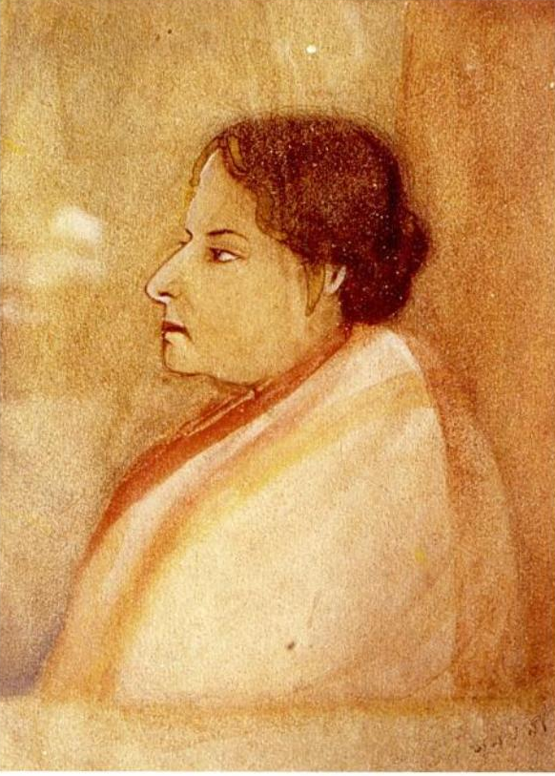
Sunayani Devi
Birth
Education
Inspirations
Subject matter
Notes:
Sunayani Devi was a pioneering artist who is regarded as amongst the first recognized women artists in the Modern Indian Painting era. She was born in the famous Tagore family in 1875.
Her uncle, Rabindranath Tagore was the first Asian poet to be awarded Nobel Prize for Literature. Her brothers, Abanindranath Tagore and Gaganendranath Tagore were both prominent artists and founders of Bengal School of Art. They were highly educated and attended the prestigious Calcutta School of Art.
However, Sunayani Devi wasn’t as blessed as her brothers. The society and the social structure in India in the 19th and 20th century did not allow women to rub shoulders with men to an extent that she had no formal education. Refusing to be overshadowed by her brothers & supported by her husband, Sunayani Devi took up Painting and pursue her dreams. In fact, she took up the brush only at the age of 30.
She was the first artist to take inspiration from the Village Pata art. In her painting, we see how with her instinct for line and form, a distinct movement & rhythm and her creative imagination, she has raised the Pata art which was practiced by the village folks, and raised to the level of classical art.

Slide 5
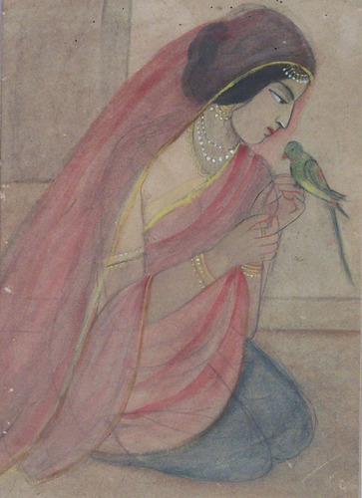
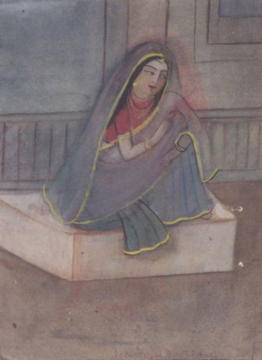
Paintings
.
Woman with a Pet
Seated Women
Notes:
The subject matter of her art belonged to a private inner world. She mostly painted scenes of domesticity drawing from her own life and tribulations. These scenes of domesticity are always tinged with a sense of melancholy and loneliness, and reflected a yearning for freedom.
There is a rhythm in her drawings and a naïve simplicity of colour and composition like the early Indian miniatures. These qualities can be seen in her paintings like Seated Women and Woman with a Pet.

Slide 6
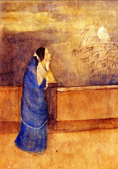
Viraha
Notes:
Viraha means the feeling of separation. Sunayani Devi mostly painted scenes of domesticity, drawing from her own life and tribulations. These scenes of domesticity are always tinged with a sense of melancholy and loneliness, and reflected a yearning for freedom

Slide 7
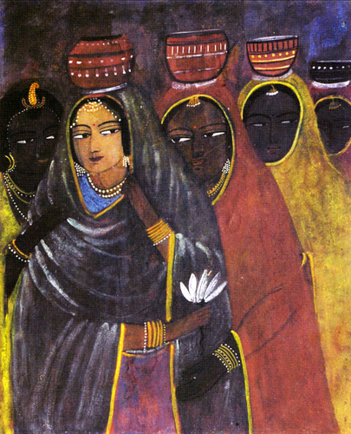
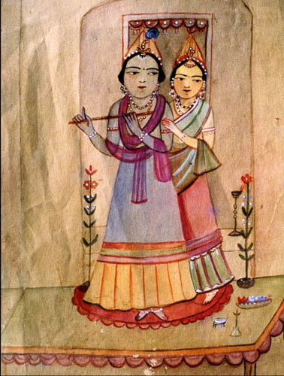
Radha and Krishna
Milkmaids
Notes:
Dr. Stella Kramrich has written beautifully about her studies of women and girls . “Vigrous fatigue ,the relaxation of a fully grown, fully ripened life, clings-dark red, dark green –round girlish faces. Their sarees are not made of cloth but of some tender mood –so expressive are they. They are no longer garments, but cradles which rock with motherly solicitude the pensive, mysterious being of young girls who have learnt the secret before it is told. Therefore their eyes do not look about ;they know where they are messengers from world within, the world veiled by the sweep of red and green sarees. It is through these eyes, long and steady ,yet alert like wagtails, that their thoughts and feelings are sent out and enliven the picture.”
Stella Kramrisch was an American art historian, who was well known as a specialist in Indian art and Hinduism

Slide 8
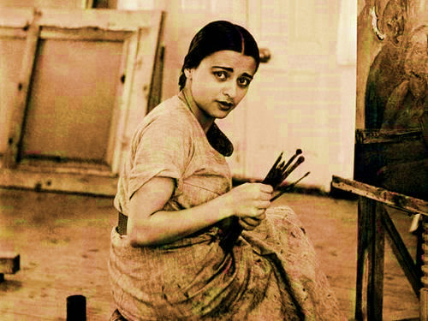
Amrita Sher-Gil

Slide 9
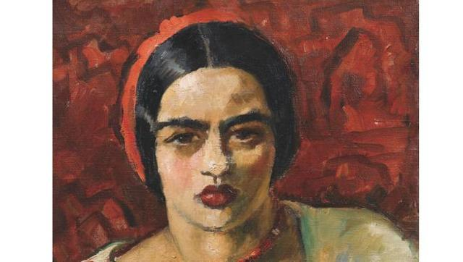
Background
Birth
Education
Influences
Subject
Transformation
Notes:
Amrita Sher-Gil was born in 1913 in Hungary. She was one of the eminent artists of India, sometimes referred to as India’s Frida Kahlo
She is considered as one of the nation’s most celebrated Indian female artists. She studied painting from Ecole Nationale Superieure des Beaux Arts, Paris and returned to India in 1934 and died in 1941.
She was always receptive to all kinds of influences which interested her and she drew inspiration from Ajanta, Kushna sculptures, Basohli miniature paintings, etc. She assimilated certain principles of modern French painting as an aid to her own individual methods of expression.
Though her life was short lived; but during those few years, Amrita chose to paint on a wide variety of subjects. She did hundreds of sketches and studies of men and women as well as many landscapes & diverse themes. However, amongst all her paintings, those around women and their activities stand out. A large part of this could be attributed to the fact that depiction of females was more prevalent in her art, be it the self-portraits or paintings of females from her family & friends or the village women who attracted her.
It is notably to see the transformation which both the artist in Amrita as well as her subjects for paintings underwent from the time she started to paint to when she moved to India.

Slide 10
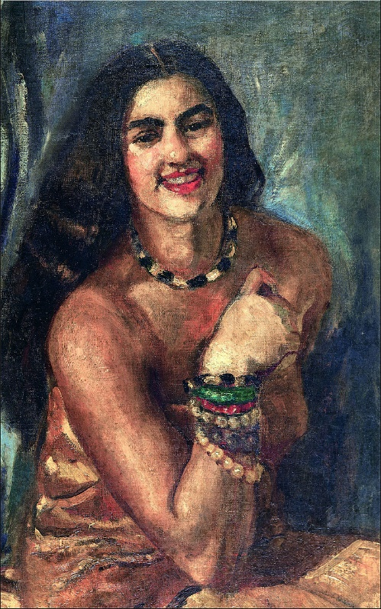
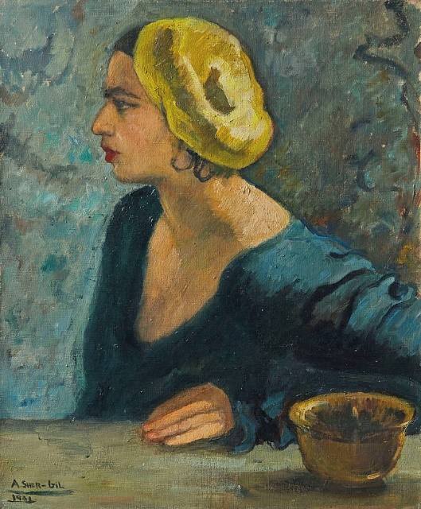
Self Portraits
Notes:
When she first started her art, she started off with sketches and soon moved to self-portraits. She then progressed to paint family & friends to finally, dedicating most of her paintings to village women when she moved to India. Since she was completely unfamiliar with the milieu both social and family when she came to India, she was fascinated by them; their cloistered shackled lives through which they moved like shadows. This mood of sorrow prevails in all her paintings. All the female figures painted by her, those of women, have lackluster eyes, an expression of resignation and despondency writ large on their drawn faces.
Looking at the beautiful self-portraits done by her we find significant projection of her personal image. The perfect example of this is Self-portrait where she has painted herself against a flaming red background, revealing her desire to assert the individuality of her character in a dramatic way. She painted with great speed, not giving much thought to what she was doing. These qualities can be seen repeatedly in her other Self portraits painted in 1930 and 1931. All of them were oil paintings using bright colors with a happy theme.

Slide 11
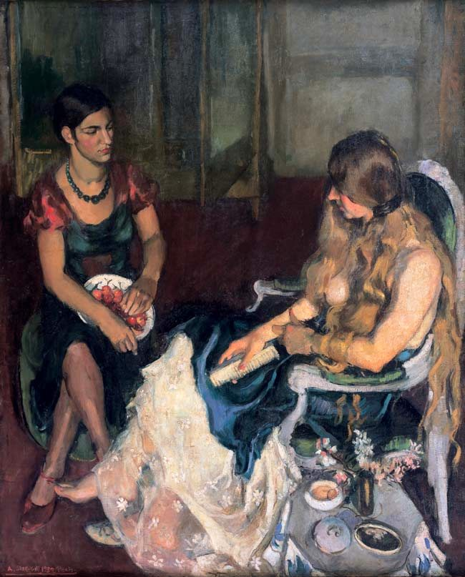
Young Girls
Notes:
Soon, she moved beyond her self-portraits. Her early paintings display a significant influence of the Western modes of painting, especially as practiced in the Bohemian circles of Paris. The perfect example of this is Young Girls, the picture was awarded a gold medal at the Grand Salon of 1933 the critics were especially impressed by the way the young artist was able to convey so many tonal variations of the colour white. In this painting Amrita’s sister Indira sits on the left dressed in fashionable European clothing, while the partially undressed figure in the foreground is a French friend. The two women, one poised and assured, the other more awkward with her face hidden beneath her messy hair, have been described as embodying different sides of Amrita herself

Slide 12
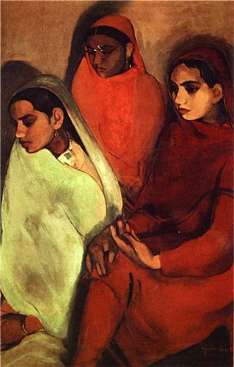
Three Girls
Notes:
This dichotomy continued to dominate her paintings though drifted towards melancholy. A classic example of this can be seen in Three Girls. Painted in 1935 shows three young Indian women sitting passively as if waiting for their future to appear. These are clearly rural women, dressed in brightly coloured saris. The mood, though, is far from joyful: the shadows on the wall suggest that the girls’ anticipated lives – complete with husbands and families – may not bring the happiness that their culture has taught them to expect.

Slide 13
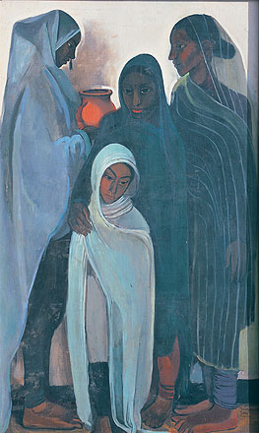
Hill Women
Notes:
Hill Women is another example of the same depiction of females but painted in hills which impart a sense of dignity to the figures, yet there prevails a passive, melancholic mood in the static images.
With paintings like Hill Women and Three Girls, she had experimented with the use of shadows to create rounded forms

Slide 14
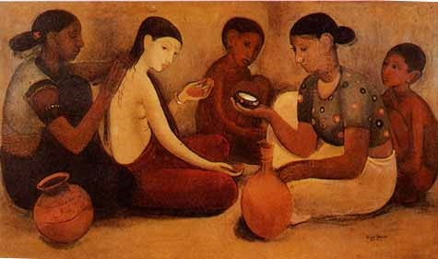
Bride ‘s Toilet
Notes:
The sadness & sense of helplessness continued to dominate her whilst showing women in activities. In yet another painting - Bride's Toilet, we see the typical characters of her style having lackluster eyes, an expression of resignation and despondency writ large on their drawn faces. Despite her remarkable stylistic affinities with Gauguin, she was moving more and more towards an individual style of her own, that is, towards greater simplification of form and elimination of unimportant details. Before this painting that is by 1936, she had seen the Ajanta frescoes that left a deep impression on her style and colour schemes. In Bride's Toilet, this influence is seen.
Here we have the same Ajantesque simplification of physique and the same reliance on clear outline and firmly moulded form. By this time, she had achieved that perfect blending of western techniques and Indian spirit, which no Indian painter had been able to achieve till then. She had laid the foundation of modern Indian art.
The painting shows a young bride surrounded by female relatives as she prepares for marriage, her pale attenuated body contrasting strongly with the rounded fecundity of the figure to the right.

Slide 15
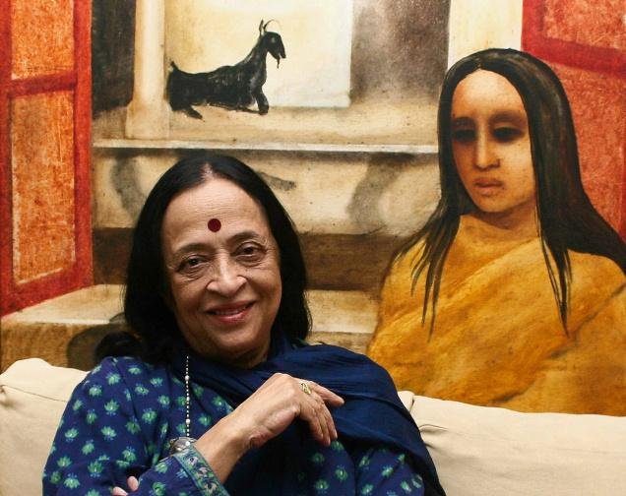
Anjolie Ela Menon

Slide 16
Birth
Education
Subject
Influences
Notes:
Anjolie Ela Menon was born in 1940 in Burnpur, West Bengal. After graduating in English literature from the University of Delhi, she moved to Paris on a scholarship from the French Government.
Anjolie Ela Menon has been wandering for many years in techniques reminiscent of old masters in its feeling for depth and space while not confining herself to the oil medium but experimenting freely with such diverse materials as acrylics, inks, computers, photography and collage.
We can find the varied influences in her early works like of Van Gogh, the Expressionists, Modigliani, Amrita Sher Gil and M.F.Husain. Travelling to different countries also influenced her art. Many of her works have been inspired by visits to Romanesque cathedrals and churches in France and visits to Greece and Russia, which reinforced the Byzantine influence.

Slide 17
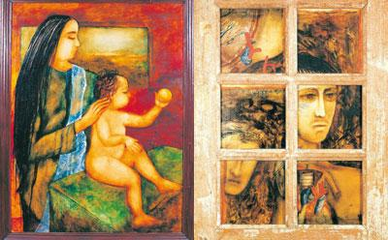
Mother and Child
Notes:
With regards to her women paintings, she has painted many women centric paintings – expressing a woman’s inner self in varied ways. A woman’s inner self is full of inherent contradictions – she can be tender and yet a pillar of strength in the face of adversity; sensuous but yet a tigress when it comes to protecting her children and so materialistic with love of jewellery but yet can be a monk when it comes to caring & giving.
An essential part of a woman – the caring mother who can be sensuous at the same time. Her women are usually sensuous with well moulded figures and an earthly attraction.
Two great examples of this can be seen in her painting “Mother & Child” as well as in the portrait of her own daughter-in-law & granddaughter “Vandana & Madhavi”.

Slide 18
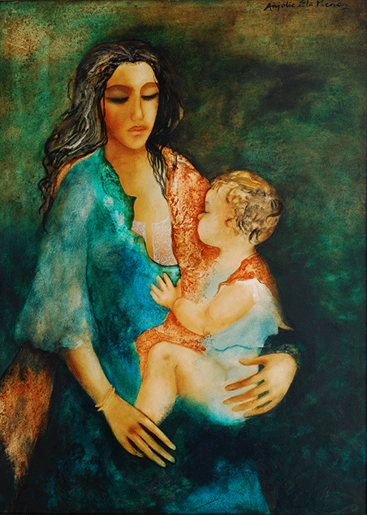
Vandana and Madhavi
Notes:
In her painting “Vandana & Madhavi”, she reiterates the beauty of a woman, yet a care displayed by a firm grip of the child. Every nuance stands out. In the words of Ritika Kochhar, a renowned journalist from India, “When I’ve finished staring at the contentment of mother and daughter, I have to admire the luminosity and texture of the green fabric on a green background. Very few artists could render colors and composition like this. You can even feel the heaviness of the baby”.

Slide 19
Devi ‘or ‘Kali’
Notes:
A classic example of this can be seen in her painting ‘Devi ‘or ‘Kali’. Instead of the traditional head of a demon, she holds a head with almost a portrait like face of the infamous Veerapan. The present work also recalls clearly in its portrait of Veerapan and the superimposed figure of Devi on that of another both her understanding and use oif it were a kind of an autobiographic allusion, with crinkled flowing hair and four arms. Even though the face is quiet, the sense of contained intense emotion comes through clearly. This woman can also be read as an archetypal woman as is infused with Sakti.f photography and collage. The larger Devi has the face of an ordinary person almost as if it were a kind of an autobiographic allusion, with crinkled flowing hair and four arms. Even though the face is quiet, the sense of contained intense emotion comes through clearly. This woman can also be read as an archetypal woman as is infused with Sakti.
Kali is the Hindu goddess (or Devi) of death, time, and doomsday and is often associated with sexuality and violence but is also considered a strong mother-figure and symbolic of motherly-love. Kali also embodies shakti - feminine energy, creativity and fertility - and is an incarnation of Parvati, wife of the great Hindu god Shiva. She is most often represented in art as a fearful fighting figure with a necklace of heads, skirt of arms, lolling tongue, and brandishing a knife dripping with blood.

Slide 20
Mother Teresa caring for Christ
Notes:
In a similar representation but more like medieval Byzantine style can be seen in Mother Teresa caring for Christ (1998). We see Mother Teresa holding Christ body in her lap, the body is in brown colour and is more like a skeleton figure showing his pain It displays upholding the values of Christianity in a world who is witnessing a degradation of society.

Slide 21
Maya
Notes:
In another one of her paintings Maya, she employs myth and reality in her painting which shows Maya and the baby Gautama, rendered in an unusual style which is inspired by the Buddhist Tankas. The pairing is haunting and very emotive, the painting evokes the magical legend of Maya who conceived Gautama in very unusual circumstances. Maya dreamt that she got impregnated when a white elephant, entered her womb through her right side. She died a week after child birth but she reappeared in the Buddha's life, guiding him through his trials and tribulations. These legends, supported by complex imagery are gleaned from Menon's highly unique imagination. The sheer vibrancy of the beautiful embellishment in this painting makes it a visually challenging piece of art with the contemporary use of ancient iconography is used .

Slide 22
Mariam
Notes:
Menon's painting Mariam, Mariam and Christ reminds the religious icons that adorn Orthodox Christian churches. Her painting shows influence from Christian art and has a painting with a glowing aura. Mariam's gently shut eyelids reflect the compassion and love she feels for her son the baby Jesus. The child Christ reflects an intense internal energy while retaining his innocence. The halos behind their heads emphasize the divine spirit of both mother and child. This haunting figurative painting is one that lingers in the mind's eye, evoking the divinity of Mother Mary as much as that of the holy child

Slide 23
Tara
Notes:
In one more of her divine female painting Tara .The artist depicts a brilliant technique in her version of Tara who uses her Shakti to save Shiva (Shiva is one of the three major deities of Hinduism. He is known for being the God of Gods in Hinduism). The legend goes that in order to save the world from destruction Shiva drank the poison, created by the churning of the ocean between Demons and Devils. Durga, took the form of the divine mother Tara to rescue Lord Shiva. He became the baby in her lap. She suckled him and the milk from her breast acted as an antidote. One hand on her belly suggests new birth, new beginnings. The painting is a clear mix of the magical and surreal, an old, legend re-imagined in a contemporary context.

Slide 24
Conclusion
Defined and Redefined the art styles
Mirrored the Social Structure
Progression in the mediums used
Notes:
As we transverse a century of art through these three artists, we find that each one defined and redefined the art styles in their respective eras.
The works of all these pioneering artists have reflected on the social structure which existed in during their times.
However, their choice of mediums have somewhat followed the National & International progressions. From Water colors to Oil colors to finally choosing Acrylic colors as their choice of mediums. Post 1950s, as India was exposed to International styles, painters like Anjolie Ela Menon tried mixed media and other types of mediums.
Sunayani Devi has only painted using water colors.

Slide 25
The feminist focus of these artists does not totally portray the whole truth about the women in India but their works illuminates the changing society. The confidence and strength visible in the works of the three artists is an inspiration for the women in India. The remarkable thing about the works is their evocation of confidence and strength in representing graceful figures of women. These painters not only depict the romantic image of female figures but also their roles & importance in the society.

Slide 26
Thank you

